Slide 1

Verilog HDL (Intro & Structural)
Winter 1400 (Computer Aided Design)
Meisam Abdollahi
School of Computer Engineering
Iran University of Science and Technology
meisam.abdolahi@ut.ac.ir

Slide 2
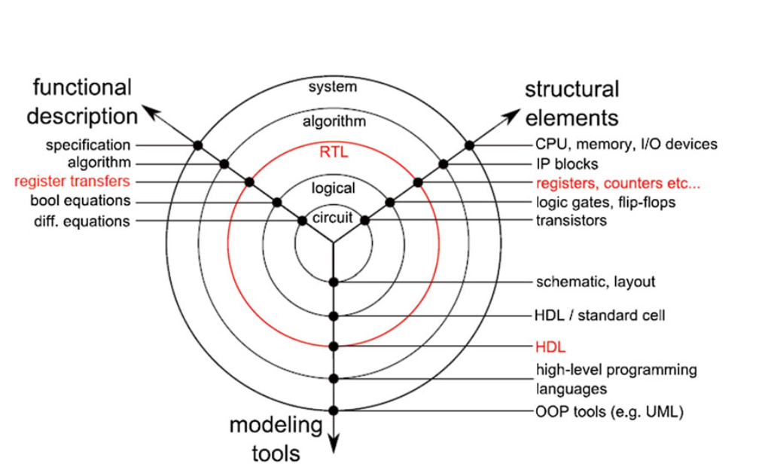
RTL Design
RTL is the abstraction level between algorithm and logic gates.
A circuit is described in terms of registers (flip-flops or latches) and the data is transferred between them using logical operations

Slide 3
Transaction Level Modeling
Transaction Level Modeling (TLM) is a technique for describing a system by using function calls that define a set of transactions over a set of channels.
TLM descriptions can be more abstract, and therefore simulate more quickly than the RTL.
Evaluation the performances and the behavior of the IP very early in the design flow

Slide 4
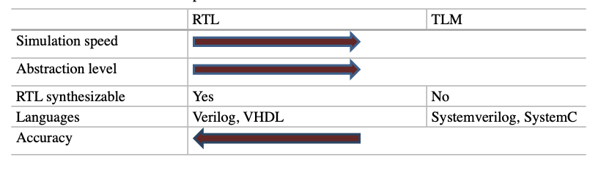
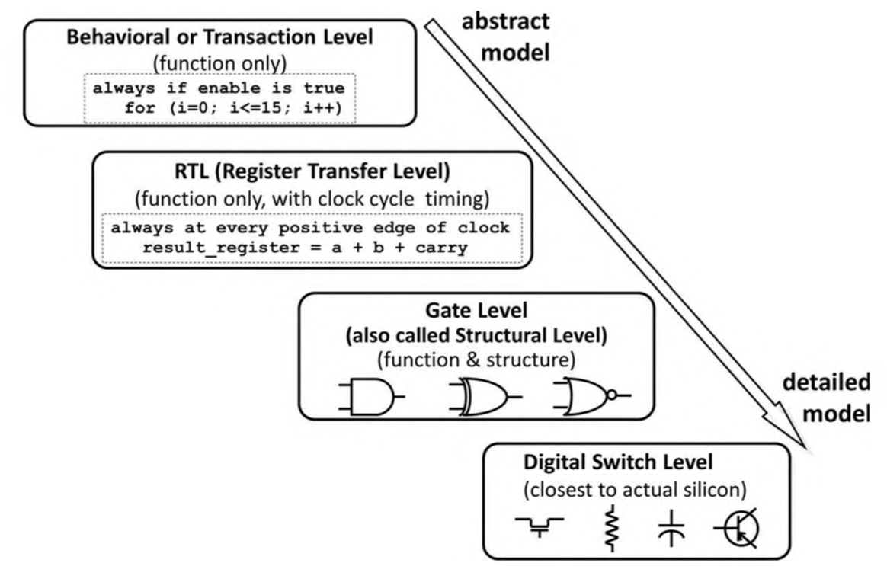
RTL vs. TLM
System C
System Verilog
VHDL
Verilog

Slide 5
Verilog - HDL
Verilog Introduction
Supports structural and behavioral descriptions
Structural
Explicit structure of the circuit
How a module is composed as an interconnection of more primitive modules/components
E.g., each logic gate instantiated and connected to others
Behavioral
Program describes input/output behavior of circuit
Many structural implementations could have same behavior
E.g., different implementations of one Boolean function

Slide 6
Verilog Structural models of combinational Logic
Module
A module is the basic building block in Verilog.
A module can be an element or a collection of lower-level design blocks.
A module provides the necessary functionality to the higher-level block through its port interface (inputs and outputs), but hides the internal implementation.
The Port
Interface List
The name of Module
module ModuleName [(Port,...)];
ModuleItems...
endmodule
The Body of Module
Represents the internal description of the module

Slide 7
Verilog Structural models of combinational Logic
Identifiers
Identifiers are the names you give your Modules, wires, gates, functions, and anything else you design or use.
The basic rules for identifiers are as follows:
May contain letters (a-z, A-Z), digits (0-9), underscores (_), and dollar signs ($).
Must start with a letter or underscore.
Are case sensitive (unless made case insensitive by a tool option).
May be up to 1024 characters long.
Other printable ASCII characters may be used in an escaped identifier.
Names in Verilog are case sensitive
The language uses certain keywords, all of which must use lowercase characters.
Notes:
Escaped identifiers begin with a backslash and end with a space character.

Slide 8
Verilog Structural models of combinational Logic
Comments
Comments may appear anywhere in a Verilog source text.
A comment designator starting with // makes the rest of the line, up to a new-line character, a comment.
The symbols /* and */ bracket a section of code as a comment, and they go across new-line characters.

Slide 9
Verilog Structural models of combinational Logic
Ports
The ports of modules model the pins or edge connectors of hardware components.
Each port in the port list is defined as input, output or inout, based on the direction of the port signal.
Ports can be declared as follows:
Port declaration:
input [range] name
output [range] name
inout [range] name

Slide 10
Verilog Structural models of combinational Logic
example
Port Definition
module Reg_8bit (Din, clr, clk, Dout);
// Port Declaration Section
input clk,clr;
input [0:7] Din;
Output [0:7] Dout;
// module internals
...
endmodule
Port Declaration
Port Definition & Declaration
module Reg_8bit (input [0:7] Din,
input clr, clk,
output [0:7] Dout);
// module internals
...
endmodule

Slide 11
Verilog-Logical Values
Logic Values
Verilog wires and variables take the 4-value logic value system
Values in this system are 0, 1, Z, and X.
Forcing 0 like a direct pull to the ground
0 :
Resistive 0 is generated when there is a large resistance between a line and a forcing 0 value
Capacitive 0 is when a line is float; but has a capacitance that has a zero charge.

Slide 12
Verilog-Logical Values
Logic Values
Verilog wires and variables take the 4-value logic value system
Values in this system are 0, 1, Z, and X.
Forcing 1 like a direct pull to the VCC (Power Supply)
1 :
Resistive 1 is generated when there is a large resistance between a line and a forcing 1 value
Capacitive 1 is when a line is float; but has a capacitance that has a VCC charge.

Slide 13
Verilog-Logical Values
Logic Values
Verilog wires and variables take the 4-value logic value system
Values in this system are 0, 1, Z, and X.
The Z value represents an undriven, high-impedance value. This is the electrical float which causes no current flow to either supply or ground voltage.
Z :
Both Z and z are acceptable forms of this logic value

Slide 14
Verilog-Logical Values
Logic Values
Verilog wires and variables take the 4-value logic value system
Values in this system are 0, 1, Z, and X.
The X value represents a conflict in multiple driving values, an unknown, an uninitialized value, a short between two opposing values (0 and 1), or a bus contention.
X :
Driven wires and Verilog variables assume X for their initial values
Both X and x are acceptable forms of this logic value

Slide 15
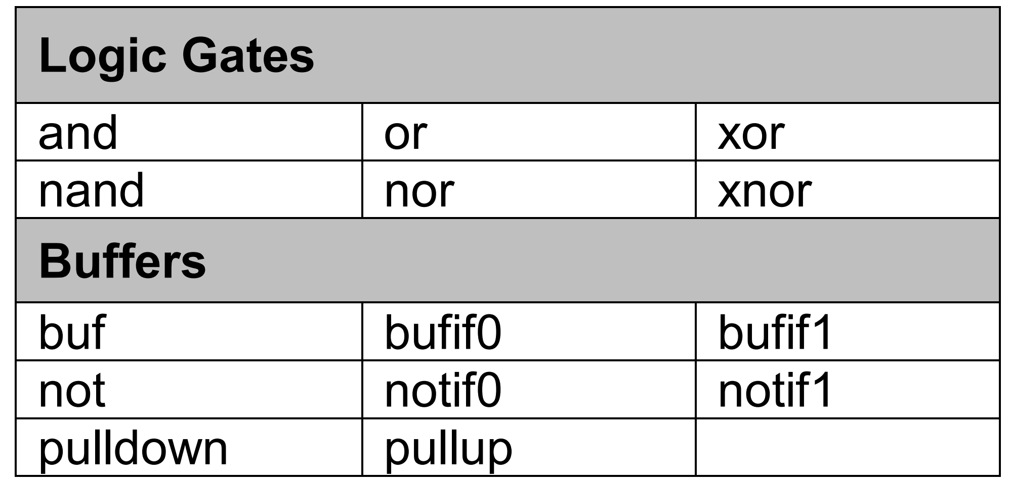
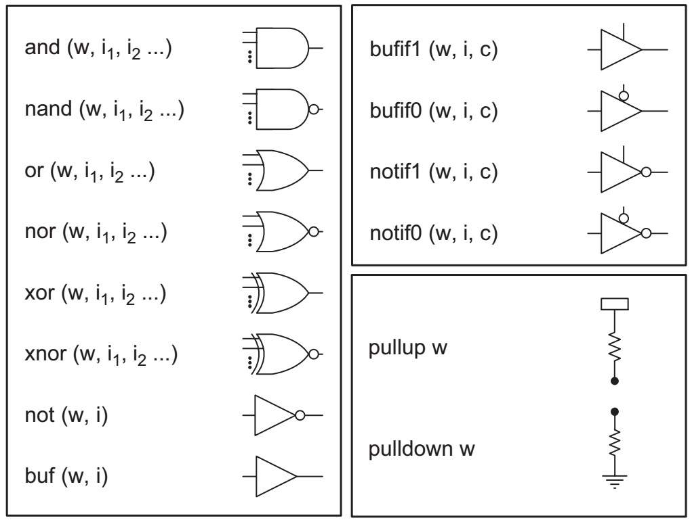
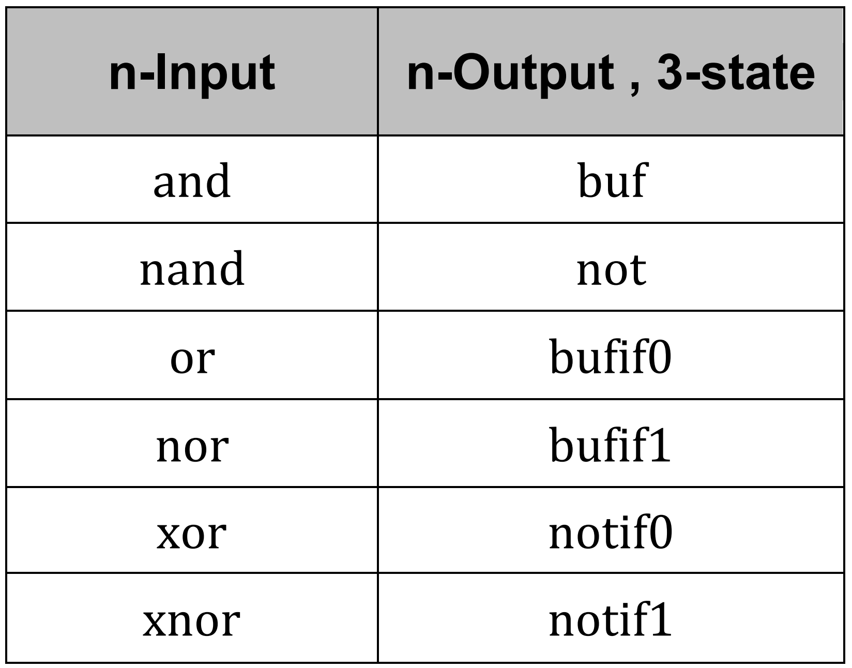
Verilog Structural models of combinational Logic
Primitive Gates
A number of primitives, or Gates, are built into the Verilog language. They represent basic logic gates (e.g. and, or).

Slide 16
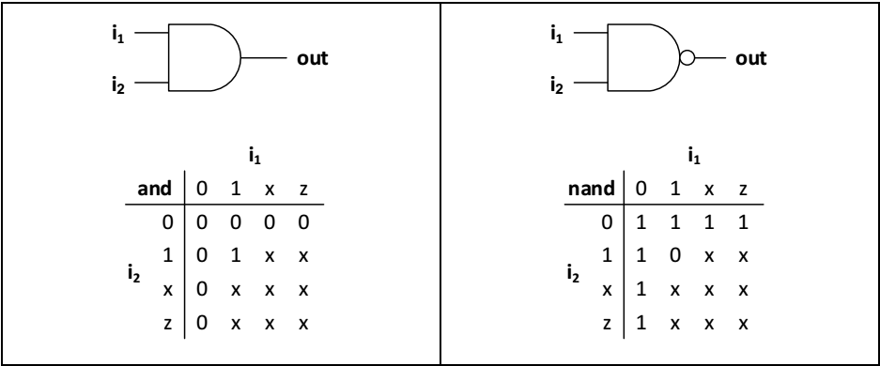
Verilog Structural models of combinational Logic
Primitive Gates (cont.)

Slide 17
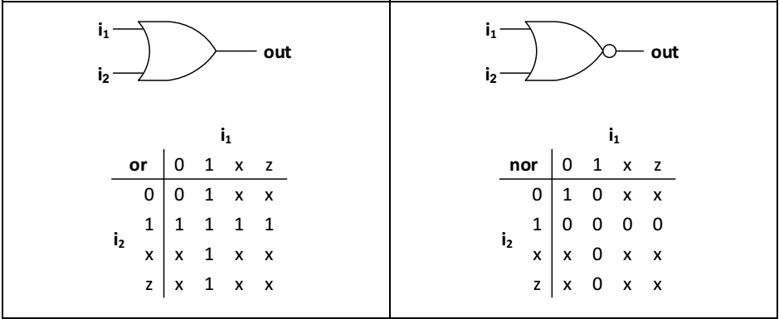
Verilog Structural models of combinational Logic
Primitive Gates (cont.)

Slide 18
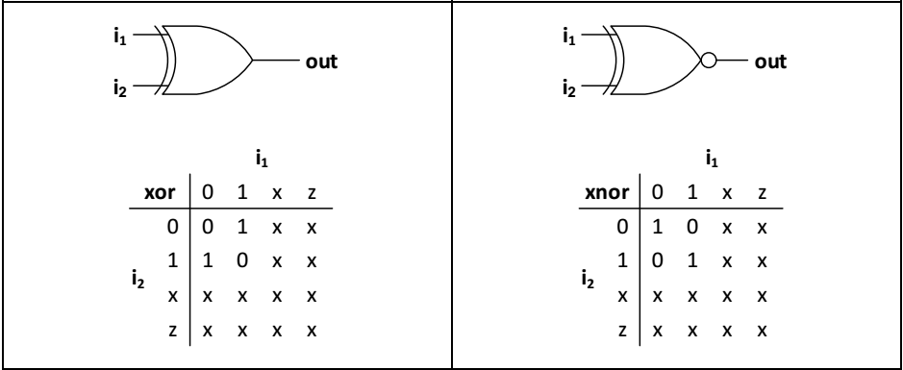
Verilog Structural models of combinational Logic
Primitive Gates (cont.)

Slide 19
Verilog Structural models of combinational Logic
Verilog Structural Model using Primitive Gates
module AOI_1 (y_out , x_in1 , x_in2 , x_in3 , x_in4 , x_in5);
output y_out;
input x_in1 , x_in2 , x_in3 , x_in4 , x_in5;
wire y1 , y2;
nor (y_out , y1 , y2);
and (y1 , x_in1 , x_in2);
and (y2 , x_in3 , x_in4 , x_in5);
endmodule
☞
Nets (sometimes called wires) are the most common data object in Verilog. Nets are used to interconnect modules and primitives

Slide 20
Verilog-Data Types
Verilog Data Types
net
Variable
There are two Data Types in Verilog HDL :
Nets : Establish structural connectivity. A net represents a hardware wire driven by one or more gates or other types of signal sources.
wire
tri
wand
triand
Net Data types :
wor
trior
supply0
supply1
tri0
tri1
trireg

Slide 21
Verilog-Data Types
Verilog Data Types
net
Variable
There are two Data Types in Verilog HDL :
Nets :
The net data types can represent physical connections between structural entities, such as gates.
it does not store values. It must be driven by something, and cannot store a value without being driven.
its value is determined by the values of its drivers, such as a continuous assignment or a gate.
wire
wand
wor
tri
tri0
tri1
trior
triand
Net Data types :
supply0
supply1
trireg

Slide 22
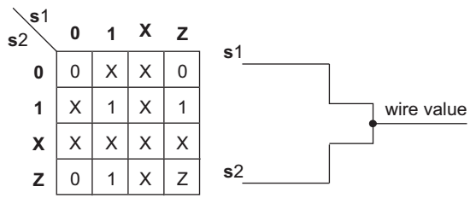
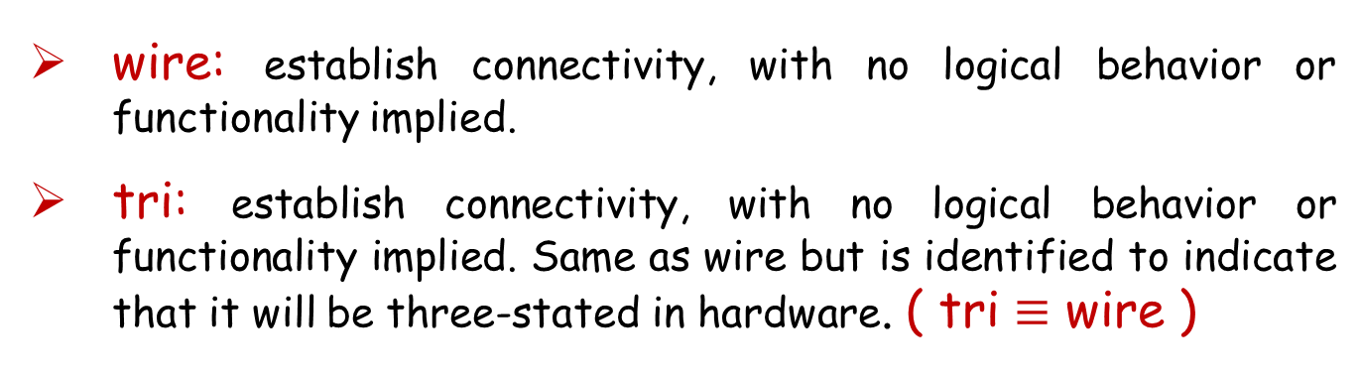
Verilog-Data Types
Net Types:
wire: establish connectivity, with no logical behavior or functionality implied.
tri: establish connectivity, with no logical behavior or functionality implied. Same as wire but is identified to indicate that it will be three-stated in hardware. ( tri $≡$ wire )
Notes:
There is no difference between wire and tri. They are synonyms.
Usually the convention is to use wire in regular declaration and tri in declaration of multiple-driven nets and inout ports.

Slide 23
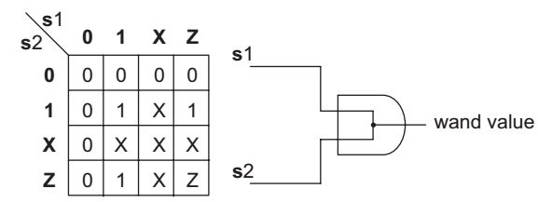
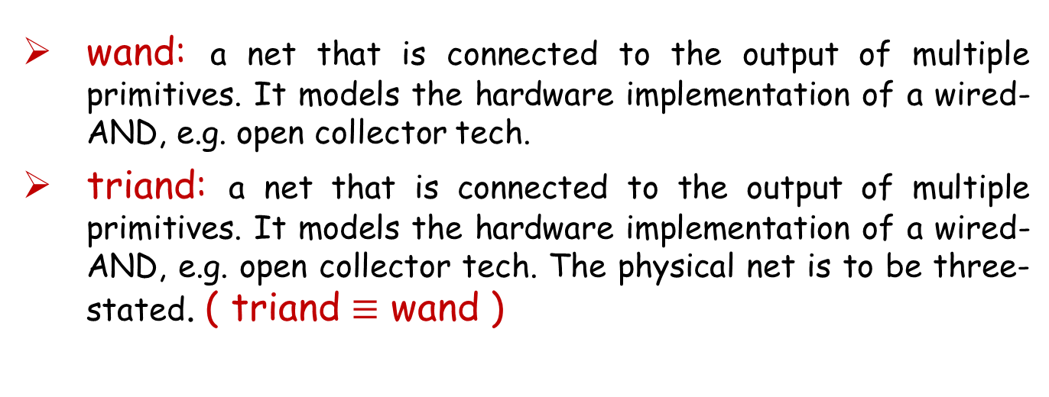
Verilog-Data Types
Net Types:
wand: a net that is connected to the output of multiple primitives. It models the hardware implementation of a wired-AND, e.g. open collector tech.
triand: a net that is connected to the output of multiple primitives. It models the hardware implementation of a wired-AND, e.g. open collector tech. The physical net is to be three-stated. ( triand $≡$ wand )

Slide 24
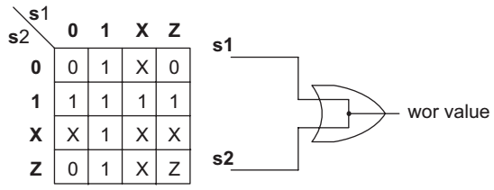
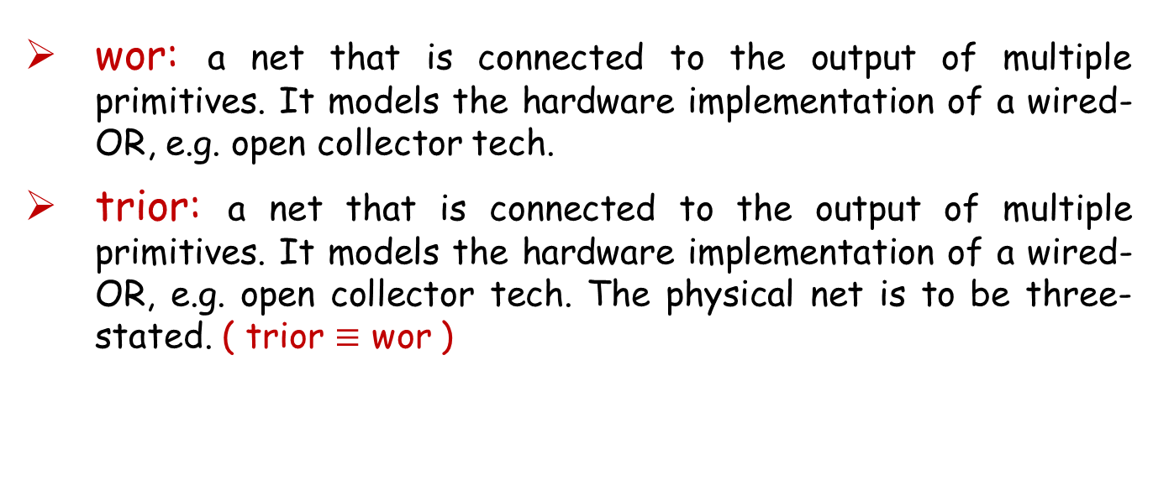
Verilog-Data Types
Net Types :
wor: a net that is connected to the output of multiple primitives. It models the hardware implementation of a wired-OR, e.g. open collector tech.
trior: a net that is connected to the output of multiple primitives. It models the hardware implementation of a wired-OR, e.g. open collector tech. The physical net is to be three-stated. ( trior $≡$ wor )

Slide 25
Verilog-Data Types
Net Types:
tri0: a net that is connected to GND by resistive pull-down connection.
tri1: a net that is connected to the Power supply by a resistive pull-up.
Notes:
When a net has no drivers, or all driving Z, a tri1 net will get pulled to the 1 state.

Slide 26
Verilog-Data Types
Net Types:
supply0: a global net that is connected to GND.
supply1: a global net that is connected to Power Supply.
trireg: The trireg type net behaves as a capacitive wire and holds its old value when a new resolved value is to become Z.

Slide 27
Verilog-Data Types
Variable Data Type:
The variable data type is an abstraction of a data storage element.
A variable shall store a value from one assignment to the next.
reg
integer
Register Data types :
real
real time
time

Slide 28
Verilog-Data Types
Variable Type:
reg: this type is an abstraction of a hardware storage element, but it dose not corresponding directly to physical memory.
A reg variable has a default value of x.
The default size of a register variable is single bit.
Verilog operators create a reg variables as an unsigned value.
A register variable may be assigned value only by procedural statement (behavioral description)

Slide 29
Verilog-Data Types
Variable Type:
integer: this type supports numeric computation in procedural statements.
Integers are represented internally to the word length of the host machine ( at least 32 bits )
An integer variable has a default initial value 0.
real : real are stored in double precision, typically a 64-bit. A real variable has a default initial value of 0.0. Real variables can be specified in decimal and exponential notation.

Slide 30
Verilog-Data Types
Variable Type:
Time: is an unsigned 64-bit quantities and used to store simulation time. A variable of type time may not be used in a module port, nor may it be an input or output of a primitive. A time variable has a default value of 0.
realtime: simply stores time as a floating point quantity. A realtime variable has a default initial value of 0.0.

Slide 31
Verilog-Data Types
Net Strength:
Two types of net strengths are drive_strength and charge_strength.
Strengths of a net used as a switch input affect the strength of the output of the switch.
Strengths of several signals driving a net, affect the way net logic values are resolved.

Slide 32
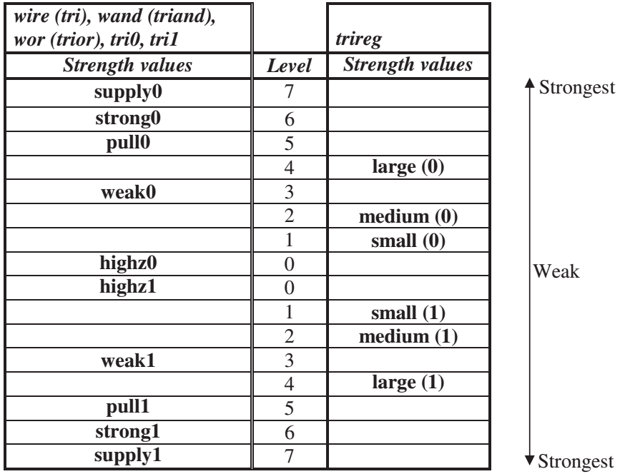
Verilog-Data Types
Net Strength :
wand (pull0, supply1) sim;

Slide 33
Verilog-Data Types
Net Strength :
The strength of storage nets specify how weak or strong the charge capability of the net is.
Three strength values, large, medium, and small are used for these net types, and the default is medium.
trireg (small) cap1;

Slide 34
Verilog-Data Types
Strength used in resolution:
Strength values are instrumental in deciding logic values of signals with multiple drivers.
If a net has multiple drivers of the same strength values, its net type, i.e., wire, wand, or wor decides on the final value of the net.
If drive strengths of multiple drivers of a net are different, conflicts are resolved by taking the logic value that has a higher strength.
In this case, resolution type of the net (i.e., wire, wand, or wor) does not play any role in determining the net value.

Slide 35
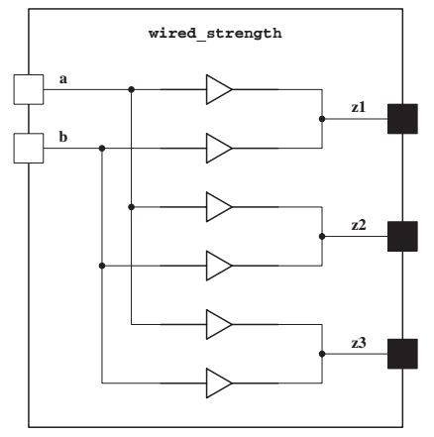
Verilog-Data Types
Example:
module wired_strength (input a, b, output z1, z2, z3);
wire y1;
wand y2;
wor y3;
buf (pull1, weak0) (y1, a);
buf (pull1, weak0) (y1, b);
buf (pull1, weak0) (y2, a);
buf (pull1, supply0) (y2, b);
buf (pull1, weak0) (y3, a);
buf (Strong1, weak0) (y3, b);
assign z1 = y1;
assign z2 = y2;
assign z3 = y3;
endmodule

Slide 36
Verilog Structural models of combinational Logic
Port connection Rules
Inputs: Internally, input ports must always be of the type net. Externally, the inputs can be connected to a variable which is a reg or net.
Outputs: Internally, output ports can be of the type reg or net. Externally, outputs must always be connected to a net. They cannot be connected to a reg.
Inouts: Internally, inout ports must always be of the type net. Externally, inout ports must always be connected to a net.

Slide 37
Modeling Hardware
The biggest difficulty is representing concurrently operating hardware.
It is needed to “simulate” the execution of several parts of the circuit at the same time.
Verilog models combinational circuits by what are called concurrent statements
These statements are evaluated any time and every time a signal on the right side of the statement changes.

Slide 38
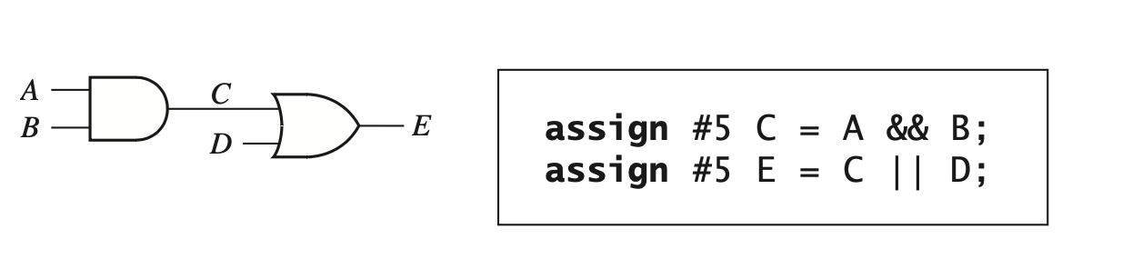
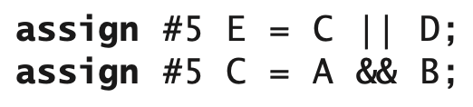
Concurrent Statement
The Verilog simulator monitors the right side of each concurrent statement, and any time a signal changes, the expression on the right side is immediately reevaluated after the defined delay.
Optional
The order is not importnat

Slide 39
Verilog Structural models of combinational Logic
Top Down Design and Nested Modules

Slide 40
Verilog Structural models of combinational Logic
Top Down Design and Nested Modules

Slide 41
Verilog Structural models of combinational Logic
Top Down Design and Nested Modules
module Half_Adder(sum , cout , a , b);
input a , b;
output sum , cout;
xor (sum , a , b);
and (cout , a , b);
endmodule
outputs are of wire type by default

Slide 42
Verilog Structural models of combinational Logic
Top Down Design and Nested Modules
module Full_Adder (sum , c_out , a , b , c_in );
output sum, c_out;
input a, b, c_in;
wire w1 , w2 , w3;
Half_Adder M1 (w1 , w2 , a , b);
Half_Adder M2 (sum , w3 , c_in , w1);
or (c_out , w2 , w3);
endmodule

Slide 43
Verilog Structural models of combinational Logic
Top Down Design and Nested Modules
module RCA_Adder_4(sum,
cout,
a, b,
cin);
output [3: 0] sum;
output cout;
input [3: 0] a, b;
input cin;
wire cin1, cin2, cin3;
Full_Adder M1 (sum[0], cin1, a[0], b[0], cin);
Full_Adder M2 (sum[1], cin2, a[1], b[1], cin1);
Full_Adder M3 (sum[2], cin3, a[2], b[2], cin2);
Full_Adder M4 (sum[3], cout, a[3], b[3], cin3);
endmodule

